Slide 1
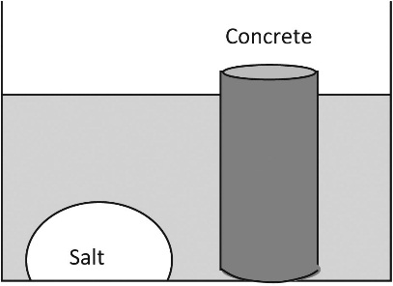
FIGURE 10.1 Schematic Diagram of Diffusion

Slide 2
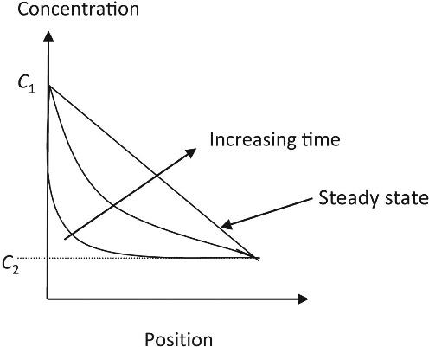
FIGURE 10.2 Effect of Diffusion on Concentration

Slide 3
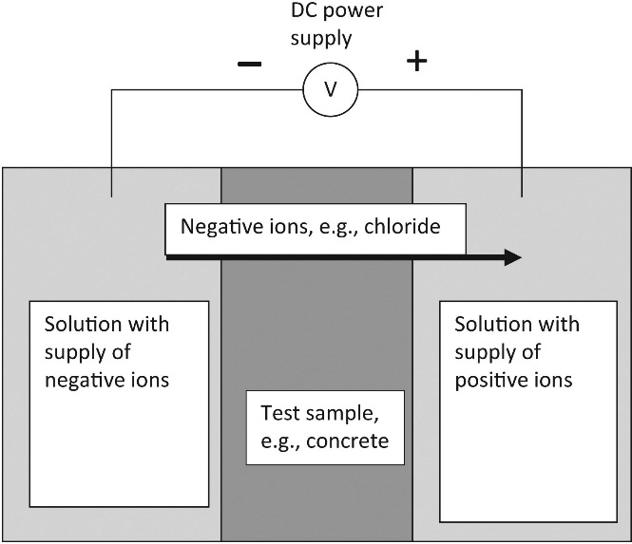
FIGURE 10.3 Schematic Diagram of Electromigration

Slide 4
